Slide 1
超越学科界限的认知基础 Transdisciplinary Cognitive Foundation Recursion, Continuation, and CICD/DevOps Week 07
Ben Koo
October 21, 2020

Slide 2
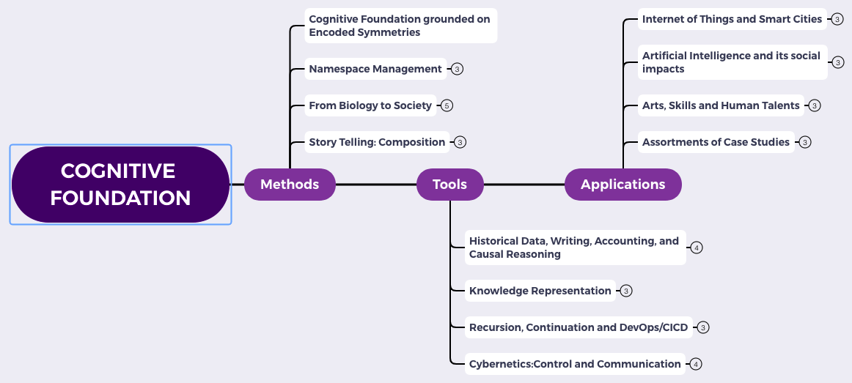
Content Themes for the semester
Overview
Namespace Management
Biology, Physics, Math, Code is Law, and Society
Story Telling, Functions/Metaphors/Analogies
Writing, Accounting, Historical Data and Temporal Reasoning
Knowledge Representation in Wiki and Files
Recursion and Continuation (DevOps/CICD)
Midterm Reports by Students
Cybernetics (Control and Communication)
Smart City and Internet of Things
Artificial Intelligence and its Social Impacts
Arts/Skills/Human Talents in the Digital Era
Student proposed Application Topics
Rehearsal
Final Reports and Celebration

Slide 3

Abstract Specification
Logic Model
Logic Model
Concrete Implementation
Context: Named Cognitive activities can be Computed at Scale
Goal: Explain the computing process
Criteria:
Consistent nomenclatures
Minimize cognitive complexity
Relate to societal practices
Output: An operational model for collective cognition
Process: Data Transformation activities
Input:
Theories on Recursive structures
Fundamental “bridging” analogies
Industrial practices at work
A well-defined set of Actions and iterative Branching Strategies
A Roadmap of composable activities
Sequencing and timing conditions
Explicitly state dependencies and resource requirements
Boundary Conditions: This lecture requiries reader to related and compare multiple fields of concepts

Slide 4
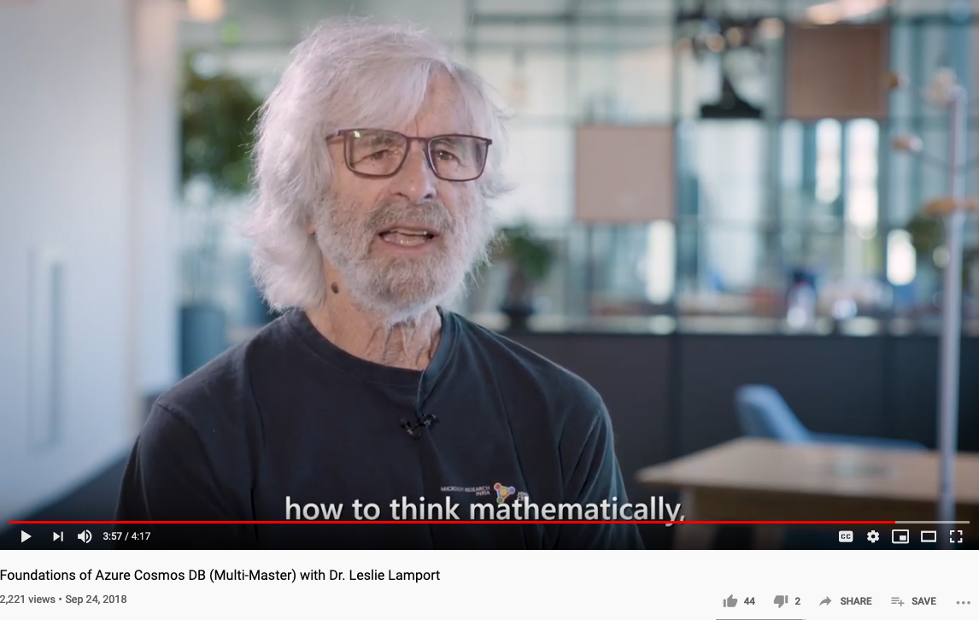
How to Think Mathematically?
Huawei VP Mr. Yang Shaoqing
RICH 70 Tsinghua SEA Cloud Forum, Sep 14, 2020
H. E. Bambang Brodjonegoro,
Minister of Research & Technology, Indonesia
Russel once said: “Mathematicians’ job is about classifiying.”
Mathematics is the art of giving the same name to different things.^{[10]} Henri Poincaré

Slide 5
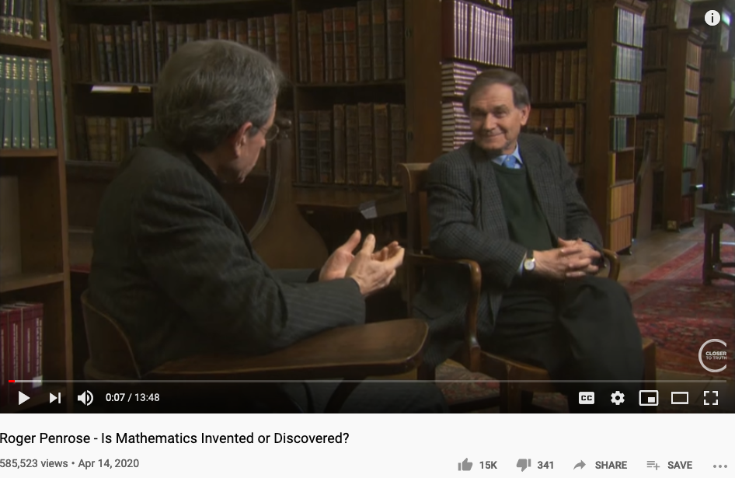
Is Math Invented or Discovered?
Huawei VP Mr. Yang Shaoqing
Video last tested: October 24, 2020.

Slide 6
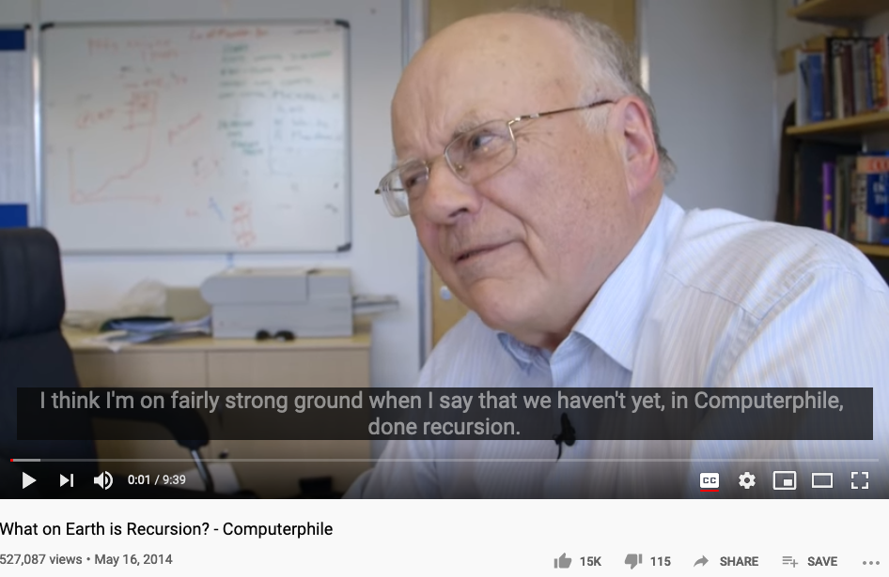
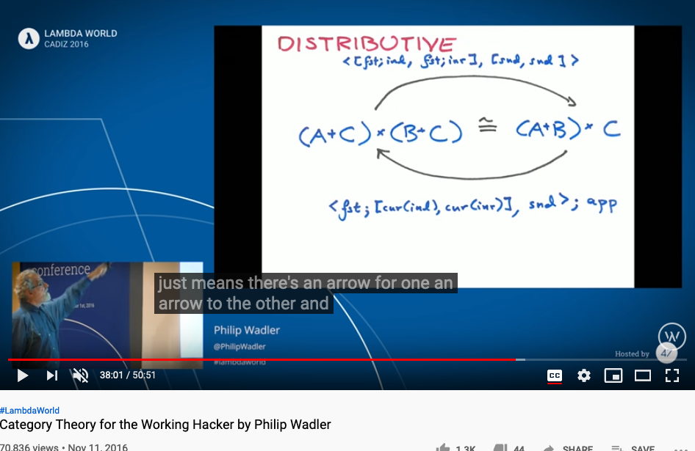
Is Recursion Invented or Discovered?
Huawei VP Mr. Yang Shaoqing
Video last tested: October 24, 2020.
Video last tested: October 24, 2020.

Slide 7

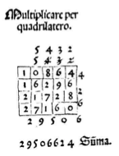
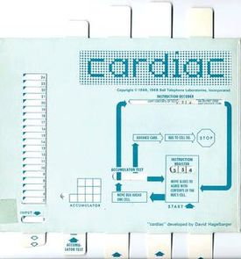
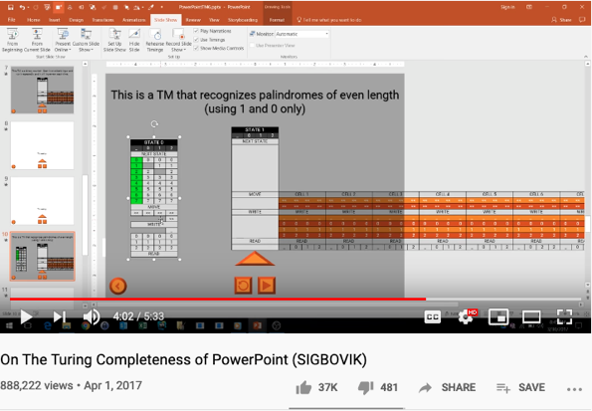
Computational Operations on Paper
https://youtu.be/uNjxe8ShM-8
A way to perform multiplication using matrix layout in Pacioli’s book.

Slide 8



Metaphors and Story Telling

Slide 9
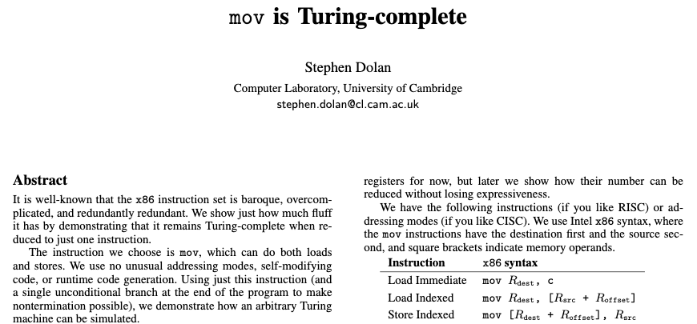
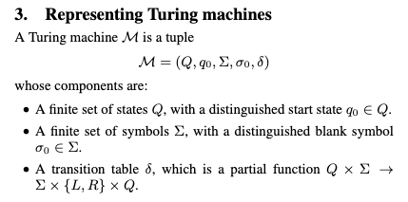
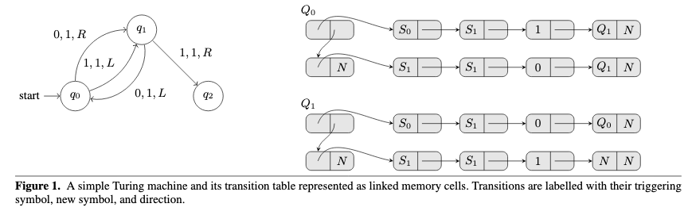
Turing Complete Instruction Set
Paper Download Link: https://drwho.virtadpt.net/files/mov.pdf

Slide 10
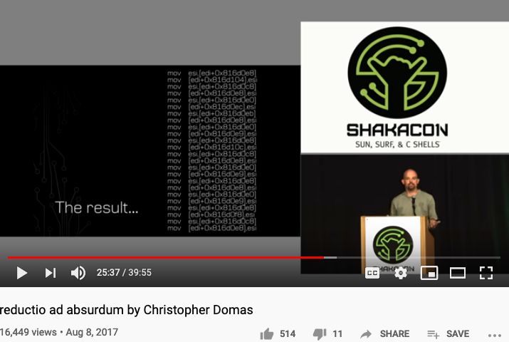
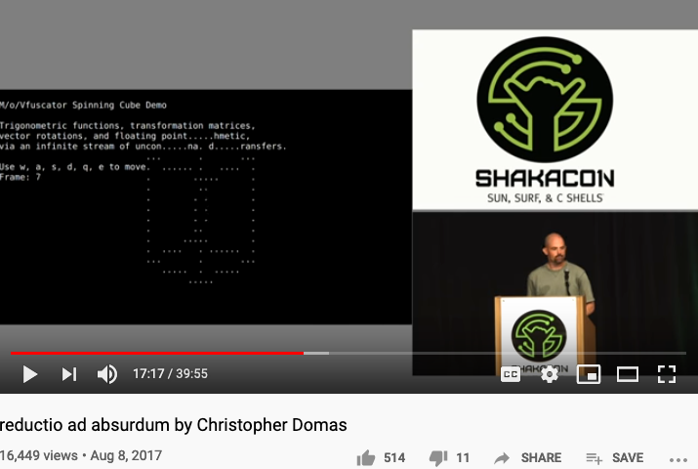
One instruction for All Computation
https://youtu.be/NmWwRmvjAE8?t=1037
Representing all computational actions with just one instruction, MOV

Slide 11
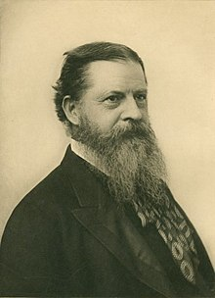
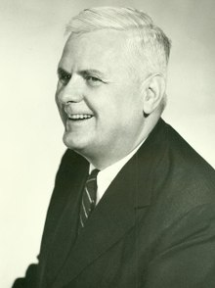
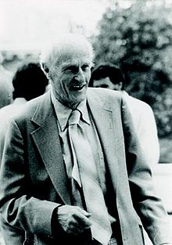
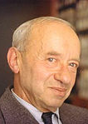

The Sources of these Ideas
Charles Sanders Pierce
Alonzo Church
Stephen Cole Kleene
Alfred Tarski
Dana Scott

Slide 12


Charles Sanders Pierce and Arrows
The NOR operator is also known as Peirce's arrow—Charles Sanders Peirce introduced the symbol ↓ for it,^{[1]}
Charles Sanders Pierce

Slide 13
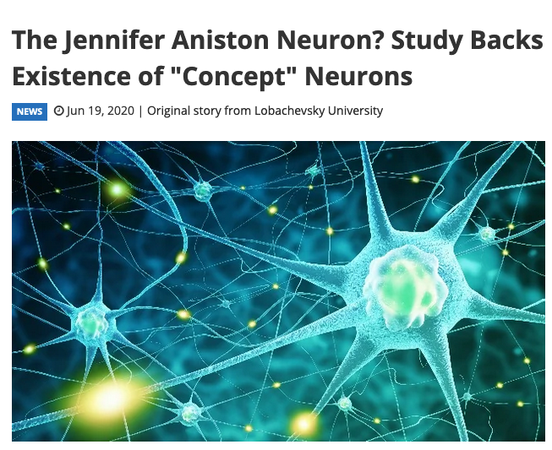
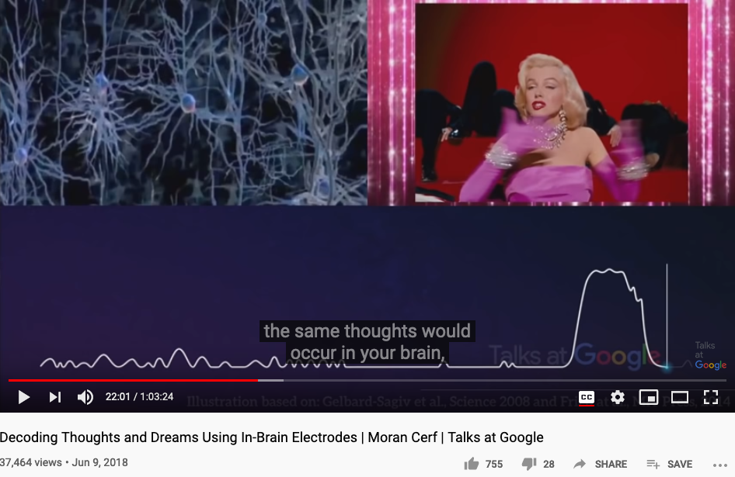
Charles Sanders Pierce and Arrows
The web report
Google Talk 2018 by Moran Cerf

Slide 14
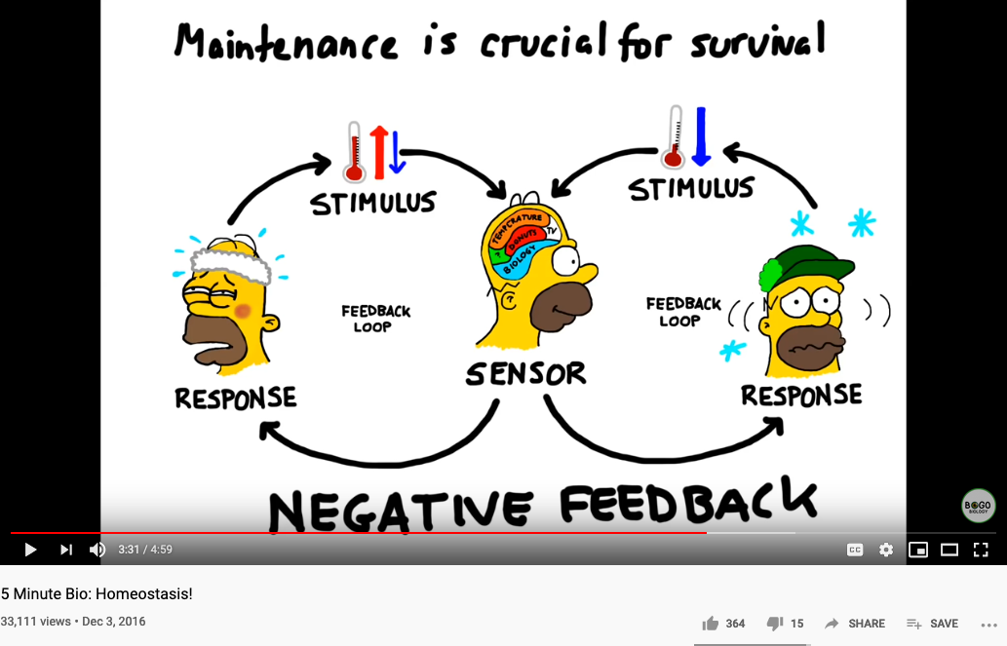
Biology and Physiology

Slide 15
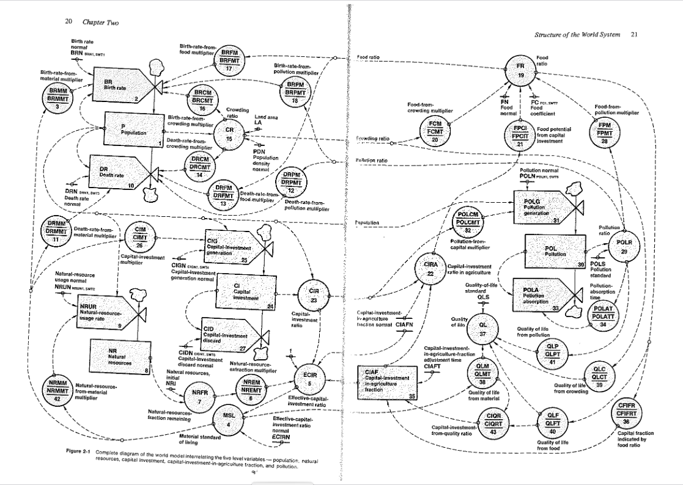
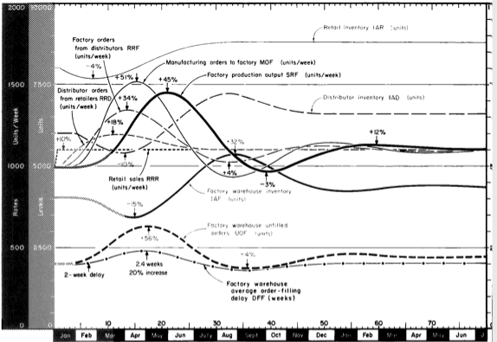
Industrial and World Dynamics
The World is made of three kinds of things:
Stock, Flow, and State variables parameterized in time

Slide 16
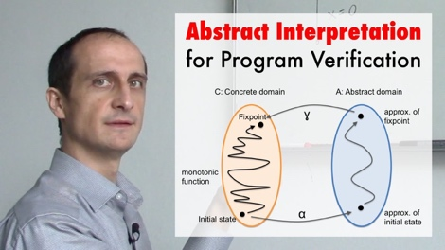
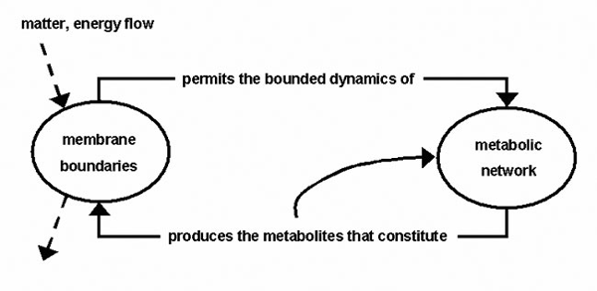
NsM under a Biological/Economic Control System
Image Source: From autopoiesis to neurophenomenology: Francisco Varela's exploration of the biophysics of being,
DAVID RUDRAUF, ANTOINE LUTZ, DIEGO COSMELLI, JEAN-PHILIPPE LACHAUX, and MICHEL LE VAN QUYEN

Slide 17

Abstraction
Concretization
Serve as the Control Plane
Define Policies according to high level objectives
Security roles protected by tech not by political influence only
Law enforcement by controlling targeted resources in the Data Plane
Serve as the Data Plane
Resources governed by Configurable Policies
Security-sensitive infrastructure that assigns traceable responsibilities to persons
Provide feedback from real worlds to reflect on the efficacies of laws
A well-defined set of Actions and iterative Branching Strategies
A Roadmap of composable activities
Sequencing and timing conditions
Explicitly state dependencies and resource requirements
Namespace (Data Asset) Management

Slide 18
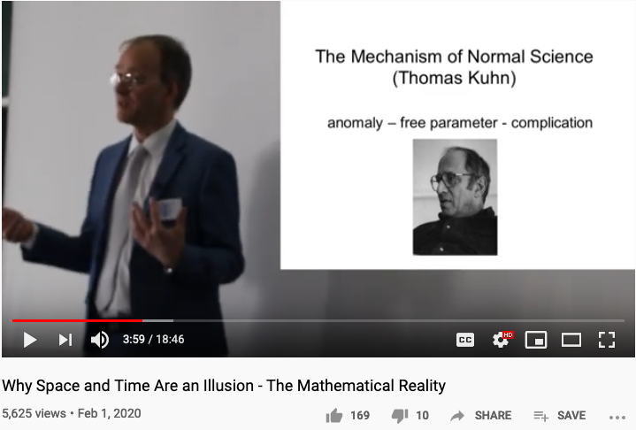
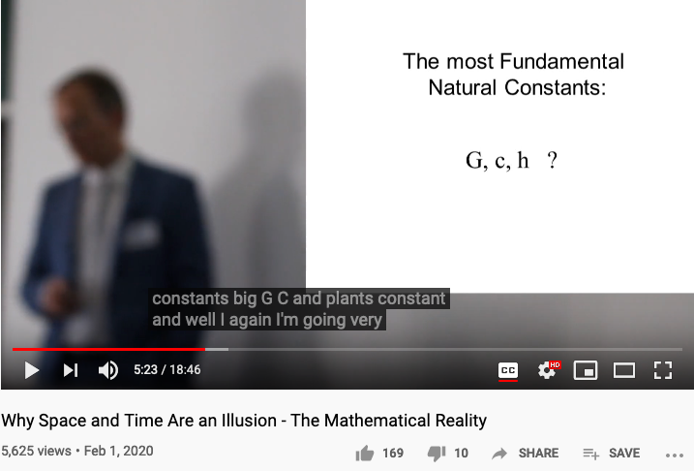
Reserved Names and Constants in Sciences
Unzicker’s Observations:
Revolutions in physics have always eliminated arbitrary numbers
A complete theory of reality must do without any constants of nature
https://youtu.be/zxAV_Re4OWA?t=239
https://youtu.be/zxAV_Re4OWA?t=323
On the origin of constants C and h, by Alexander Unzicker, last accessed Oct 20, 2020

Slide 19
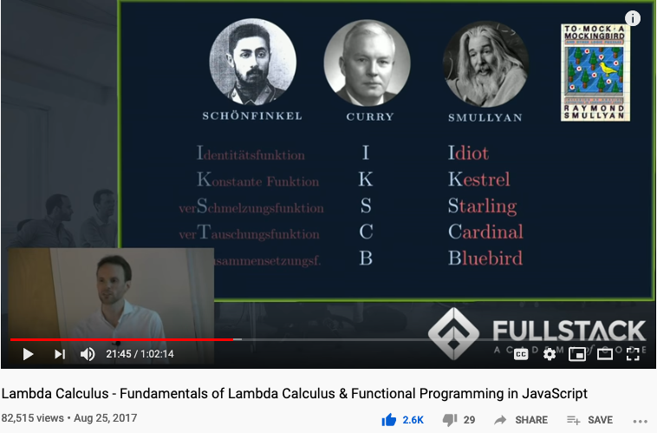
Computable Logic and Types of “Birds”

Slide 20
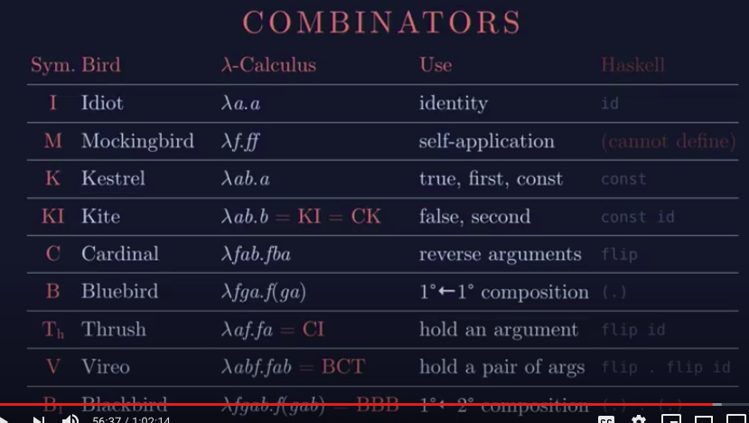
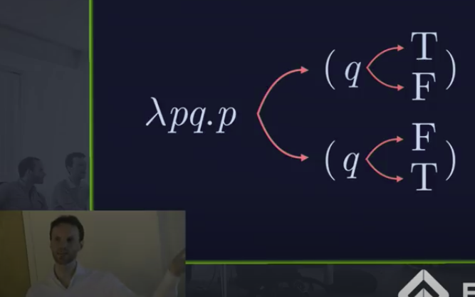
The Names of Birds (Functions)

Slide 21

Concrete Activities in Daily Workflow
What is DevSecOps?
Image courtesy: Paladion Corporation Website Image source: https://www.paladion.net

Slide 22
Glossary
Terms related to Name Space Management:
Ontology/本体论: the philosophical study of being. (Wikipedia)
Epistemology/知识论: a theory of knowledge, (Standord Philosophy Encyclopedia)
Universal Resource Locator/Indicator(URL/URI) : a string representing global resources
NsM related Ideas:
CAP Theorem: Consistency, Availability, and Performance face contentious tradeoffs.
System properties: Correctness = Liveness * Safety, Trust-worthy Data

Slide 23
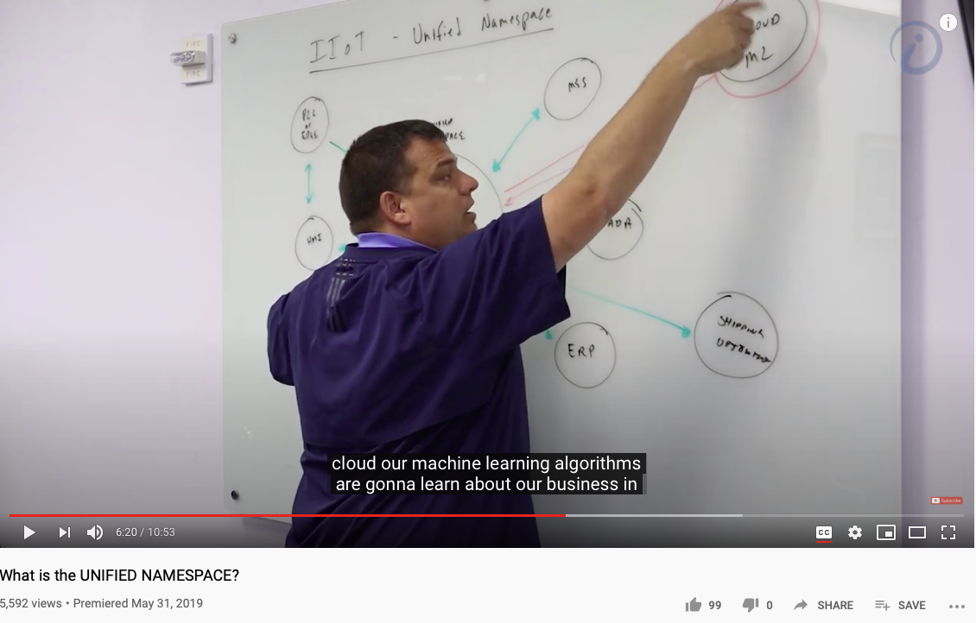
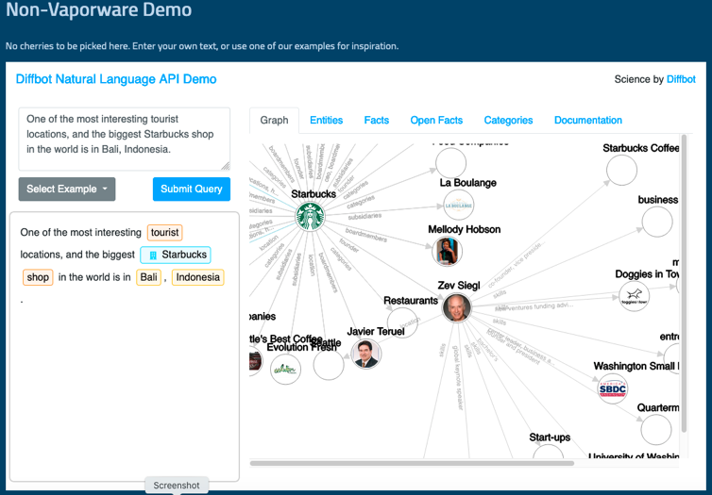
Unified Namespace

Slide 24
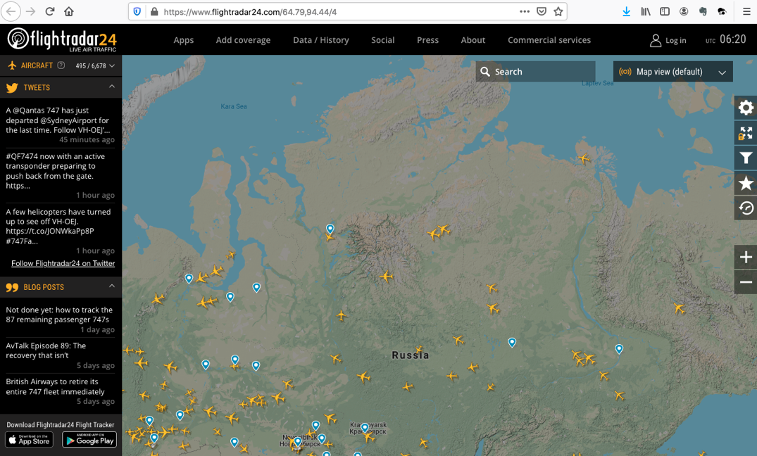
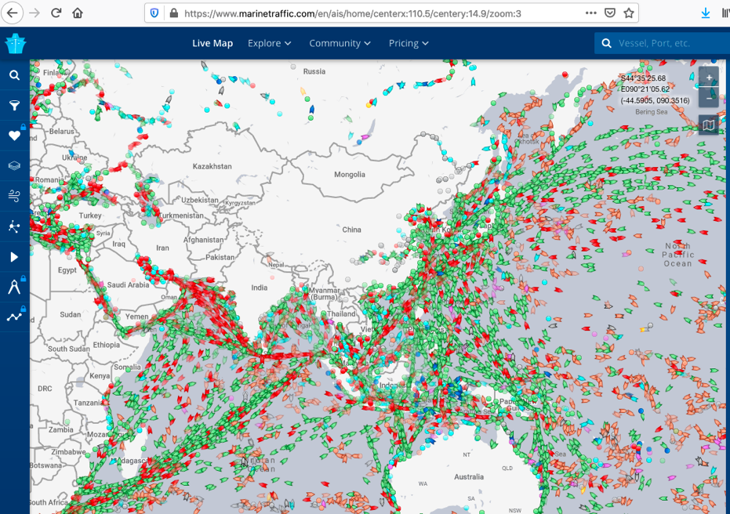
Get access to Live Data Now!
https://www.flightradar24.com/
https://www.marinetraffic.com/

Slide 25


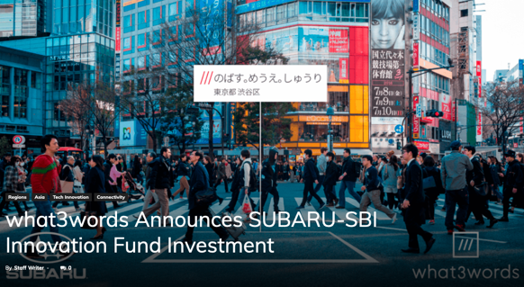
An example of Namespace Management

Slide 26
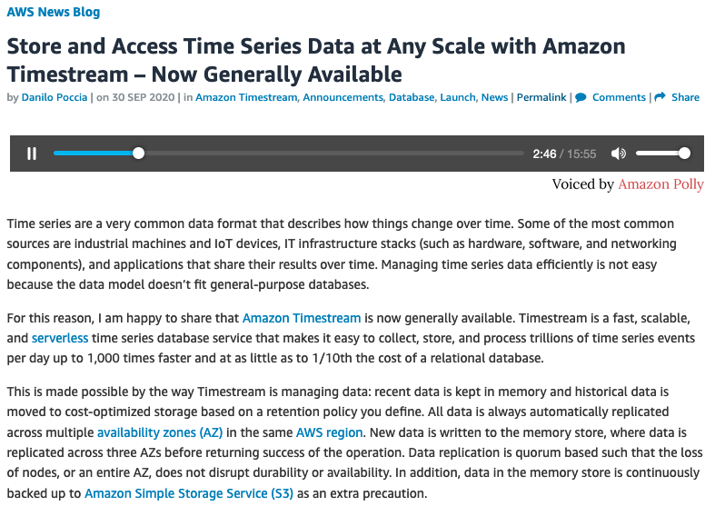
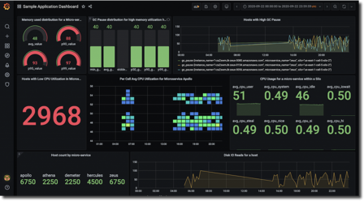
Namespace Management in Time

Slide 27
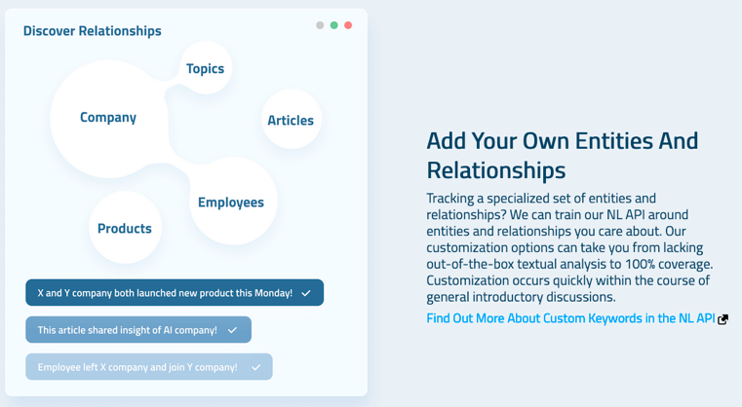
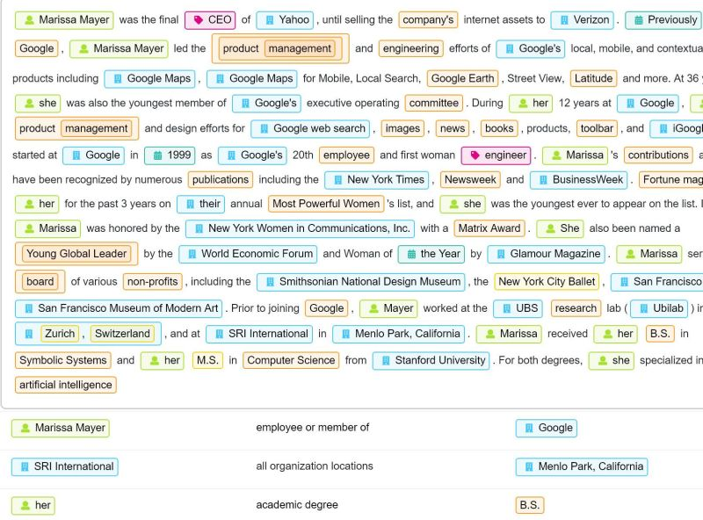

Diffbot (more than 1 Trillion linked entities)

Slide 28
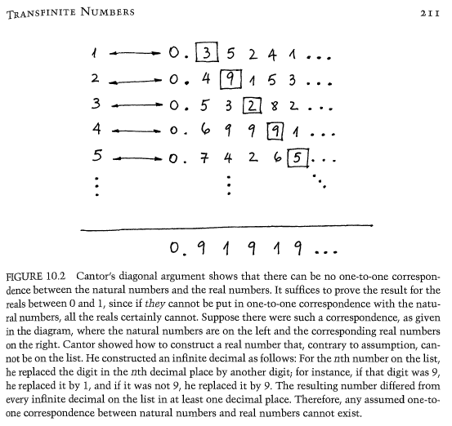
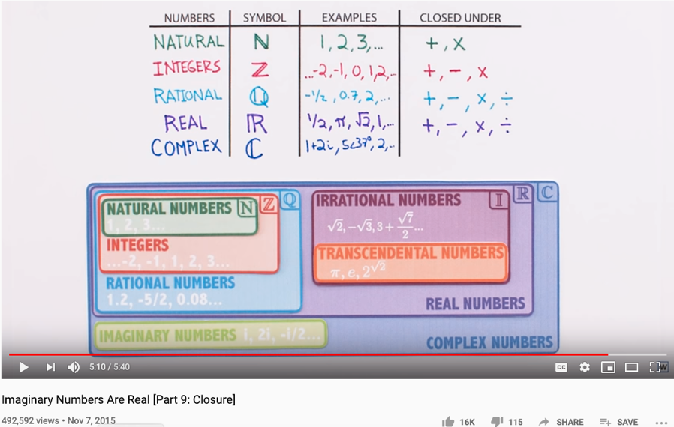
The Complete set of Generative Names
Huawei VP Mr. Yang Shaoqing
RICH 70 Tsinghua SEA Cloud Forum, Sep 14, 2020
H. E. Bambang Brodjonegoro,
Minister of Research & Technology, Indonesia

Slide 29
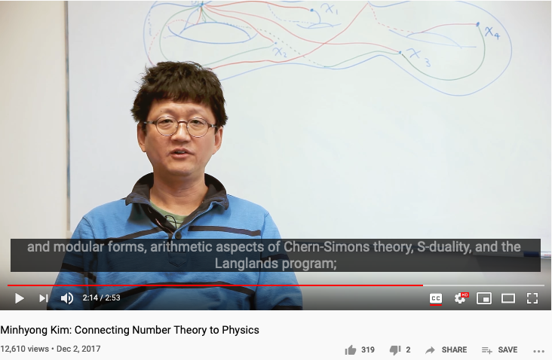
Number Theory, Physics, and Geometry
Huawei VP Mr. Yang Shaoqing
RICH 70 Tsinghua SEA Cloud Forum, Sep 14, 2020
H. E. Bambang Brodjonegoro,
Minister of Research & Technology, Indonesia
Ninhyong Kim has been a research professor of number theory at the University of Oxford and the head of their number theory research group.

Slide 30
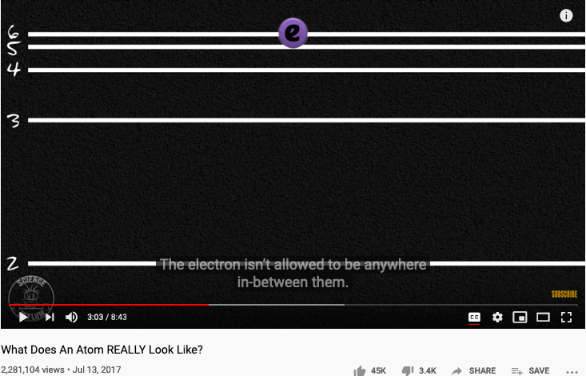
The origin of Atomic Elements
Huawei VP Mr. Yang Shaoqing
RICH 70 Tsinghua SEA Cloud Forum, Sep 14, 2020
H. E. Bambang Brodjonegoro,
Minister of Research & Technology, Indonesia

Slide 31
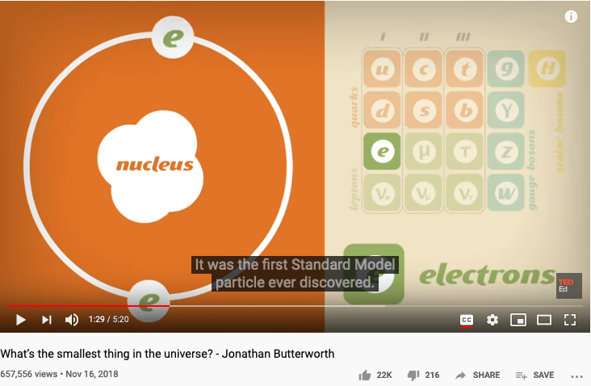
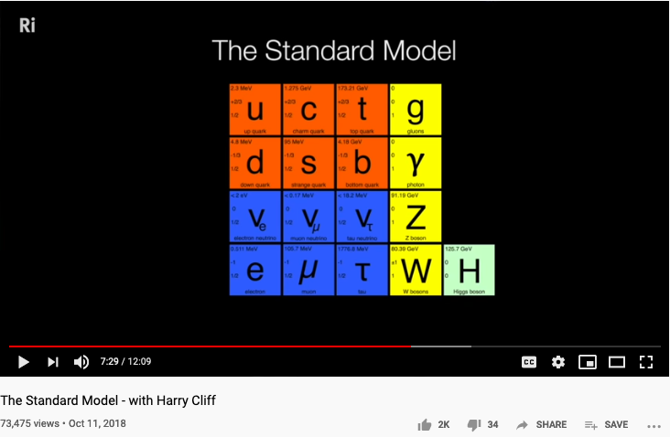
The known set of Elementary Particles
Huawei VP Mr. Yang Shaoqing
RICH 70 Tsinghua SEA Cloud Forum, Sep 14, 2020
H. E. Bambang Brodjonegoro,
Minister of Research & Technology, Indonesia

Slide 32
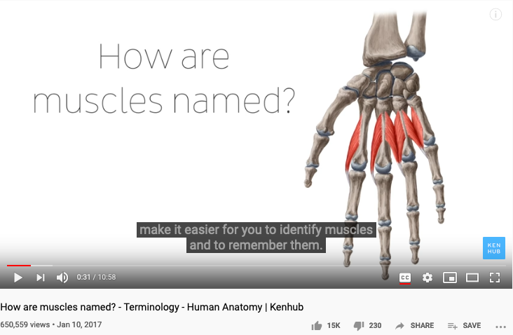
The way medical doctors talks about Human Anatomy
Huawei VP Mr. Yang Shaoqing

Slide 33


How mathematicians and musicians talks about Music
Huawei VP Mr. Yang Shaoqing
RICH 70 Tsinghua SEA Cloud Forum, Sep 14, 2020
H. E. Bambang Brodjonegoro,
Minister of Research & Technology, Indonesia

Slide 34
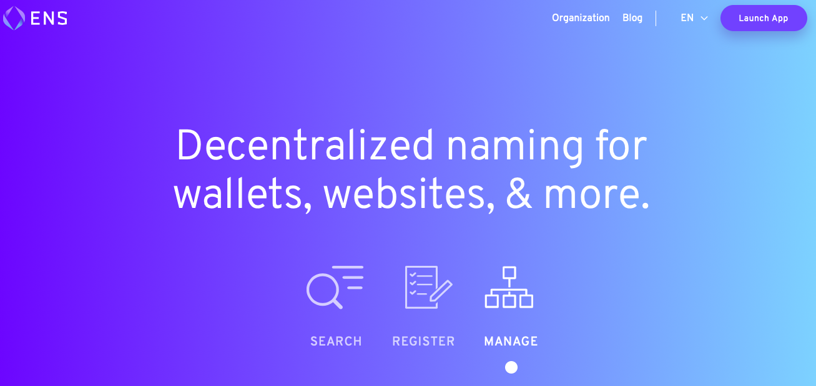
A Way to Get Internet Domain Name Service
Huawei VP Mr. Yang Shaoqing

Slide 35
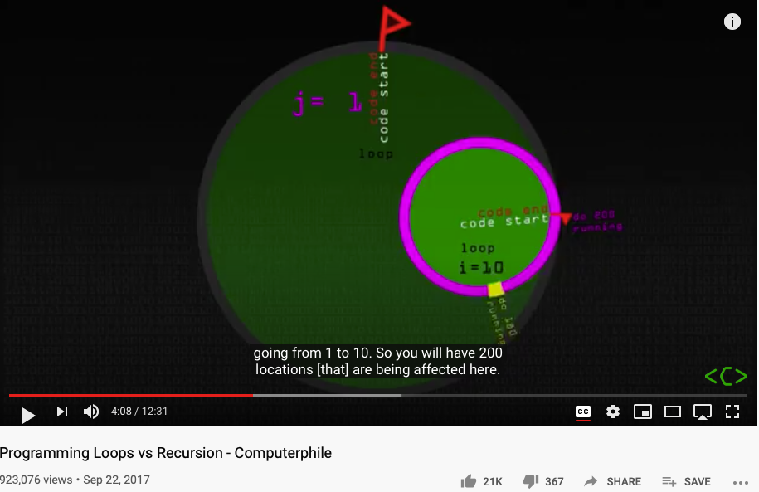
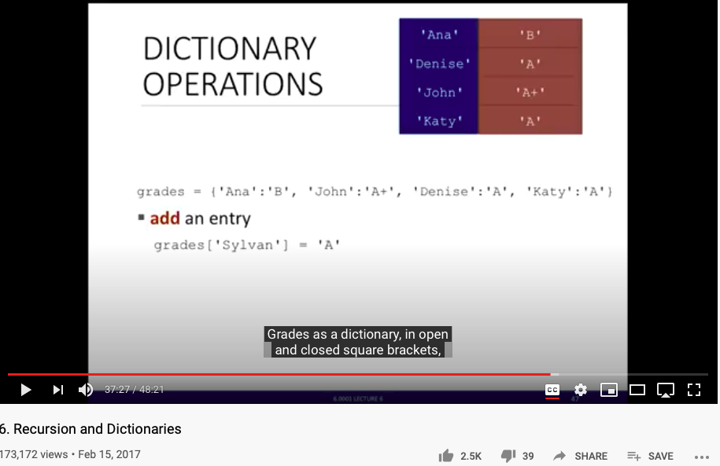
NsM in Loops and Recursion

Slide 36
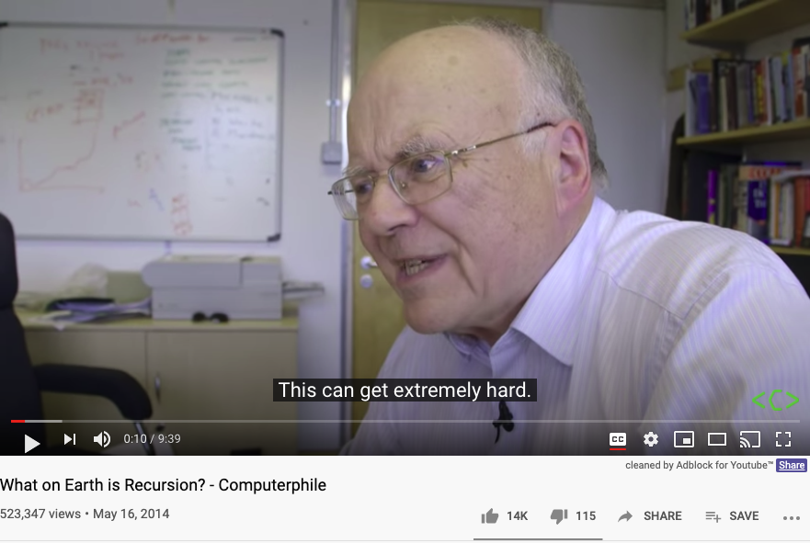
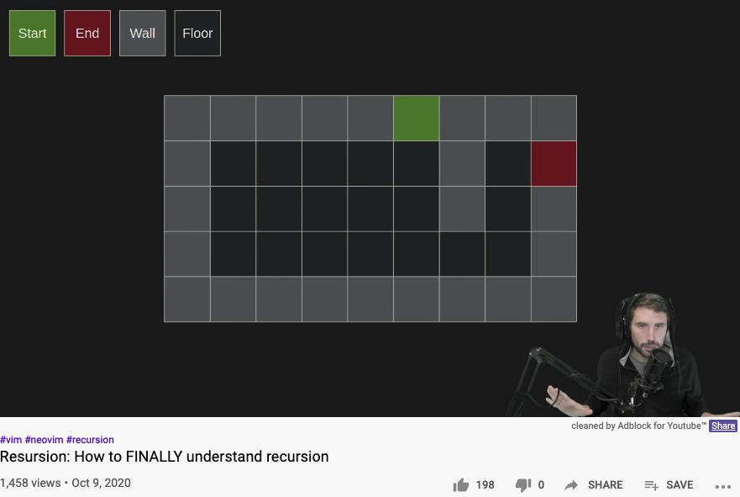
Another Round at Recursion

Slide 37

Lecture Outline

Slide 38

Arts and Sciences of NsM
History of Names
Patterns of Names
Trust-worthy Names
Namespace management is the Cognitive Foundation.

Slide 39


Names gave birth to Cognitive Abilities - Laozi
Huawei VP Mr. Yang Shaoqing
RICH 70 Tsinghua SEA Cloud Forum, Sep 14, 2020
H. E. Bambang Brodjonegoro,
Minister of Research & Technology, Indonesia

Slide 40



The History of True Names
Huawei VP Mr. Yang Shaoqing
RICH 70 Tsinghua SEA Cloud Forum, Sep 14, 2020
H. E. Bambang Brodjonegoro,
Minister of Research & Technology, Indonesia
How Gods are forgotten:
https://youtu.be/xgyMY9w7-ew?t=278

Slide 41


The Meaning of being True
Huawei VP Mr. Yang Shaoqing
RICH 70 Tsinghua SEA Cloud Forum, Sep 14, 2020
H. E. Bambang Brodjonegoro,
Minister of Research & Technology, Indonesia
Russel once said: “Mathematicians’ job is about classifiying.”
Mathematics is the art of giving the same name to different things.^{[10]} Henri Poincaré

Slide 42


The Necessity of Named abstractions
Huawei VP Mr. Yang Shaoqing
Through abstraction, only compute truth within the domain of interest!
So that it can by pass the Halting Problem.

Slide 43
How to Think Mathematically?
Huawei VP Mr. Yang Shaoqing
RICH 70 Tsinghua SEA Cloud Forum, Sep 14, 2020
H. E. Bambang Brodjonegoro,
Minister of Research & Technology, Indonesia
Russel once said: “Mathematicians’ job is about classifiying.”
Mathematics is the art of giving the same name to different things.^{[10]} Henri Poincaré

Slide 44

True Name defined by Wikipedia

Slide 45

Intensive and Extensive Properties

Slide 46




Labels, Linguistics, and Cognitive Science
Image Source: https://georgelakoff.com/

Slide 47



The expressive power of Names (labels)
Huawei VP Mr. Yang Shaoqing
Prof. George Lakoff

Slide 48

Categories are Containers of cognitive concepts
Huawei VP Mr. Yang Shaoqing

Slide 49

Patterns of Categories/Classification of Concepts
Grounded Ideas:
Adding (+): including objects into a collection
Subtraction (-): taking objects away from the collection
Sets: containers of elements
Abstract Ideas:
Numbers as points on a line
Geometrical figures as algebraic equations

Slide 50




Combine Operands/Operations as constructed names?
Cayley Table

Slide 51


Names as Generalized Metaphors
Huawei VP Mr. Yang Shaoqing
RICH 70 Tsinghua SEA Cloud Forum, Sep 14, 2020
H. E. Bambang Brodjonegoro,
Minister of Research & Technology, Indonesia

Slide 52


The properties of being Trust-worthy name schemes
Soundness:
All names refer to at least one legal entity
Completeness:
All legal entities must all have at least one name
Controlled Access Rights
Non-repudiation:
Every name only points to one unique legal entity
Tamper-Proof:
Authorized entities can make changes
Any change to the name system must become public knowledge
Time-based:
All name changes should be time-stamped by one coherent clock
Huawei VP Mr. Yang Shaoqing
RICH 70 Tsinghua SEA Cloud Forum, Sep 14, 2020
H. E. Bambang Brodjonegoro,
Minister of Research & Technology, Indonesia

Slide 53



“Mathematics is the art of giving the same name to different things!” - Henry Poincare

Slide 54

NsM at Scale!
Relations on the Web
URL: Universal Resource Locator
Universal Data Formats
Physical Objects connected through Namespaces

Slide 55





Namespace Management on the Global Scale
Berners-Lee called his vision for the web “utopian.”
He wanted it to be a place where all people had access to the best information at any time.

Slide 56





The origin and the Future of the “Web”
Theodore Gray created an Editable Interface for Computable Documents.
The technology is based on Mathematica, and was bundled with NeXT computers used by Berners-Lee.
Notes:
Wolfram|Alpha demo phrase
China's GDP over the sum of GDP of Japan and USA

Slide 57




Namespace Management with Open AI
An “open” Artificial Intelligence resource that is available for “free”.
It will do your software development work for you for free, too.

Slide 58


Methods and Tools
MediaWiki as a Tool
Data in MediaWiki/Wikipedia
Templates and Categories
Structures and Strategies in Namespace Management

Slide 59
Time and Trust-worthiness in NsM
All Name Spaces should share a universal “clock”
The common “Historical-Trail” (time-based) of Name Spaces
So that the time-stamps would offer hints to cross-check “causal” consistency
Name Spaces should be extensible
It should follow one consistent naming convention for easy referencing
Kuhn’s Cycle provides a Generative/Cyclic Model
Name Space Authentication should be scalable and distributed
Existing mechanisms for authenticated name registration, i.e. Domain Name Services (DNS).

Slide 60

Trust-worthy Name Space?
Competence:
What can you deliver?
Reliability:
Success rate of delivery?
Integirty:
Will you ever cheat me?
Empathy:
Are you on my side?
Being More Trustworthy: The Basics
― Rachel Botsman, Jan 14, 2019

Slide 61

Authenticated Name Space?
Digital Authentication - the basics
― Dawn M. Turner (guest) on 01. August 2016

Slide 62


Public-Private Key NsM Infrastructures
The paper that changed
the direction of NsM!
What is Private Key Infrastructure?

Slide 63



Naming your Learning Actions

Slide 64


Operational Concerns
Access Rights
Editorial Decisions
Process Management
Image source: https://www.keeprunning.io/2019/09/24/workload-identity-config-connector/
Production Workflow of
Namespace Management

Slide 65
Access Rights and Secure Workflow
What is DevSecOps?
Image courtesy: Paladion Corporation Website Image source: https://www.paladion.net

Slide 66

What is DevSecOps?

Slide 67







A Model of Collective Cognitive Processes
(students/teachers)
(Smart) Social Contract Execution
Traders
Miners
Coders
(Consumers/Distributors)
Three Asynchronous
Clocks in their respective
Communities
Version Upgrade
Production Code
Function Requests
Customer Crisis
Feature Revolution
Emerging cases or
systematic attacks
(Artists/Creative Projects)
(Administrators/Witnesses)
Perform Checking
receive confirmation
commit transaction
(Content Producers/Product Designers)
(Accountants/Lawyers)

Slide 68


Kuhn Cycle: the evolution of a Namespace
Normal Science
Model
Drift
Model Crisis
Model Revolution
Paradigm
Change
Emerging cases or
systematic attacks
Product Development Process
in five stages
Commit
Build
Test
Stage
Deploy
Unknown/incompatible names introduces crisis. (incommensurability).

Slide 69
Reserved Names and Constants in Sciences
Unzicker’s Observations:
Revolutions in physics have always eliminated arbitrary numbers
A complete theory of reality must do without any constants of nature
https://youtu.be/zxAV_Re4OWA?t=239
https://youtu.be/zxAV_Re4OWA?t=323
On the origin of constants C and h, by Alexander Unzicker, last accessed Oct 20, 2020

Slide 70
Decisions are made by different kinds of People
Traders
（students/teachers）
Miners
（Administrators/Witnesses）
Coders
(Artists/Creative People)
(Consumers/Distributors)
(Content Producers/Product Designers)
(Accountants/Lawyers)

Slide 71


Observability of Multi-Scale DevSecOps Processes
Traders
（students/teachers）
Miners
（Administrators/Witnesses）
Coders
(Artists/Creative People)
Sec
Consumers/
Distributors
Dev
Ops
Content Producers/
Product Designers
Accountants/
Notary Service Provider

Slide 72

Metrics of “Namespace Services”
https://www.getambassador.io/products/

Slide 73


A Unified Namespace
What are representables?
A Portal to all Names
Human-Machine Interface
Physical and Information Sciences shares the same Challenge

Slide 74








A linguistic approach to unify the cognizance across scales
Namespace = Cognitive Space

Slide 75



Code is Law

Slide 76

A Unified Context for the Collective Cognizance
Far
Space
near
before Time after

Slide 77


Three Scales of Time
Mesoscopic：
Localized Adjustments
Time Stamp
Macroscopic:
Five Stages of Evolution
Normal Science
(commit)
Model
Drift
(build)
Model Crisis
(test)
Model Revolution
(stage)
Paradigm Change
(deploy)
Microscopic：
Process Data and Summative Result
Time Stamp

Slide 78
Time Stamped Data Preserve Event Ordering Information
Normal Science
(commit)
Model
Drift
(build)
Model Crisis
(test)
Model Revolution
(stage)
Paradigm Change
(deploy)
Time Stamp
Time Stamp
Time Stamp
Time Stamp

Slide 79

ITIL’s Introductory Video
ITIL Funadmentals shown in five stages

Slide 80


ITIL’s Five Stages of Service Deployment
Image Source: ITIL for Dummies P.39
Image Source: ITIL for Dummies P.45
The Cabinet Office refers to UK’s Cabinet.
ITIL Funadmentals shown in five stages

Slide 81

The Five stages mapped to ITIL terms
The Cabinet Office refers to UK’s Cabinet.
Image Source: ITIL for Dummies P.45
Strategy Formation
(commit to a strategy)
Designing a new Model
(build)
Transition
(test against potential crisis)
Trial Service Operations
(stage)
Continuous Improvement
(deploy)
Time Stamp
Time Stamp
Time Stamp
Time Stamp

Slide 82


The Five stages mapped to ITIL terms
Image Source: ITIL for Dummies P.226
The Cabinet Office refers to UK’s Cabinet.
Strategy Formation
(commit to a strategy)
Designing a new Model
(build)
Transition
(test against potential crisis)
Trial Service Operations
(stage)
Continuous Improvement
(deploy)
Time Stamp
Time Stamp
Time Stamp
Time Stamp

Slide 83

What is CICD and DevOps? Continuous Integration, Continuous Delivery/Deployment
Image courtesy: Peter Change on Hackernoon

Slide 84

System Integration Process
Image courtesy: Learn How to Set Up a CI/CD Pipeline From Scratch on DevOps Zone

Slide 85
Iteratively Fixing Security Problems
Technology Integration
Technology
Society
Security
Technology
Security
Society
Technology Isolation
Modified from Figure 1-1 and 1-2 of Agile Application Security: Enabling Security in a Continuous Deliver Pipeline,
by Laura Bell, Michael Brunton-Spall, Rich Smith & Jim Bird, O’Reilly Media, 2017

Slide 86



The Version Control, Built, Test, Stage, Deploy are Conducted by Human Instructions
Image courtesy: Learn How to Set Up a CI/CD Pipeline From Scratch on DevOps Zone

Slide 87
A compositional view of system correctness
Liveness
Safety
Correctness
The Theoretical Definition of System Correctness
Correctness = Liveness ∧ Safety
Liveness: Something good eventually happens
Safety: Nothing bad ever happens

Slide 88

The Commit-Built-Test-Stage-Deploy are Fully Automated
Image courtesy: Learn How to Set Up a CI/CD Pipeline From Scratch from DevOps Zone

Slide 89
Continuously Adjust the Correctness Area
Liveness
Safety
Correctness
The Inremental Change Approach promoted by DevOps/CICD practitioners

Slide 90

Automation approximates and enables Process Continuity
Image courtesy: Learn How to Set Up a CI/CD Pipeline From Scratch from DevOps Zone

Slide 91

What is DevOps? Development and Operations
Image courtesy: Riyaz Hyder on Botmetric November 2, 2017

Slide 92

Not Information Asymmetry, but promote the Principle of Information Symmetry

Slide 93

Open and then Free
Open Source
Right to use publicly available technologies and other resources in the learning process
Right to resolve conflicts in a dynamic context in digitized space
Freedom to make decisions related to one’s personal digital assets
Freedom to express one’s opinions
Free Software
Founder of Free Software Foundation, and Creator of GNU/Linux. Image credit: Wikipedia
Paraphrased from “Free Software, Free Society” by Richard Stallman

Slide 94


Service Mesh (Istio) and Human Physiology Checks and Balances Data Plane and the Control Plane
Data Plane
Control Plane
Data Plane
Control Plane

Slide 95

Awareness at many levels

Slide 96
Governance in Cyber-Physical Spaces
John Locke’s Theory of Governance
All Men(Persons) are Created Equal
Certain Basic Rights Exists Independent of Government
Government Exists to Protect those Rights
Cyberspace Governance
All User Accounts can be Equally Created
Users may do anything Independent of Cyber-Government
Cyber-Government exists to enable user rights without Breaking the Cyber-Physical System
System Engineering | John Locke | Cyberspace
Correctness | All Men are Created Equal | All Accounts are Created Equal
Liveness | Certain Basic Rights exists Independent of Government | User actions are Independnet of Cyber Governance
Safety | Government exists to Protect those Rights | Cybersecurity exists to prevent users break the System

Slide 97







DevOps for Smart Cities

Slide 98

DevOps Goals for Governance
Notes:
1. 對稱性是底層的不變性
2. 在Cyberspace上，數據、操作數據的方式、操作數據的基礎架構，是資產的根本
3. 邏輯模型是凝聚群體意識的有效框架
4. Devops 能夠高效實現不同規模的Logic Model, 藉由（不同層次）數據可視與可控

Slide 99




Cyber-Physical Space Integration
Public Domain Data
Smart Contract Data
Private
Data
Notes:
1. 對稱性是底層的不變性
2. 在Cyberspace上，數據、操作數據的方式、操作數據的基礎架構，是資產的根本
3. 邏輯模型是凝聚群體意識的有效框架
4. Devops 能夠高效實現不同規模的Logic Model, 藉由（不同層次）數據可視與可控

Slide 100


The CAP Theorem in NsM
RICH 70 Tsinghua SEA Cloud Forum, Sep 14, 2020
H. E. Bambang Brodjonegoro,
Minister of Research & Technology, Indonesia

Slide 101



Name Spaces in Databases
RICH 70 Tsinghua SEA Cloud Forum, Sep 14, 2020
H. E. Bambang Brodjonegoro,
Minister of Research & Technology, Indonesia

Slide 102





We are in the Universe, now!
Library of
Linked Knowledge
(Data Plane)
Library of Executable Algorithms
(Control Plane)

Slide 103







Abundant Tools and Data Sources can all be accessed through Web Browsers

Slide 104
Namespace Management should be operated under the Principle of Information Symmetry
Natural & Structural Symmetry: Space, Time, Energy
Data Content Symmetry: Immutable Data Service
Functional Symmetry: Algorithmic Consistency
Infrastructure Symmetry: Trust-worthy System Support
Knowledge Symmetry: Equality in Information Interpretation
Notes:
1. 對稱性是底層的不變性
2. 在Cyberspace上，數據、操作數據的方式、操作數據的基礎架構，是資產的根本
3. 邏輯模型是凝聚群體意識的有效框架
4. Devops 能夠高效實現不同規模的Logic Model, 藉由（不同層次）數據可視與可控

Slide 105

Discussion and Future Applications
Past Known efforts
Alternative Strategies?
Other Applications?
Round Table Discussion

Slide 106

Lets go back to the birth place of the World Wide Web!
Conclusion
Far
Space
near
It is all made of Names!
before Time after

Slide 107
Your action on NsM before Sep 28, 202
Start using Templates and Categories on toyhouse.wiki:81
Create a personal page with bio, using standardized Templates and Category
Make sure all Wiki pages you created follow the same Namespace convention
Start using Github to download and share files with proper NsM
Couse Github @ https://github.com/benkoo/CognitiveFoundation2020
Start writing your learning report.
Every week should include Logic Model using the standard Template
500 words or more per week

